Slide 1
Build and Deploy a Serverless app with AWS CDK and Python

Slide 2
Agenda
Introduction
What is AWS CDK?
Why AWS CDK?
What we’re going to build…
Demo

Slide 3

Intro
Blake Green
Personal website: https://greengocloud.com
Twitter: @TSgt_Green
Senior Cloud Services Architect @ Intervision Systems
7 AWS Certifications
Technical Sergeant @ US Air Force
6 years Active Duty, 7 years Reserves
Notes:
InterVision is a strategic service provider focused on business outcomes-based technology solutions. We aim to help IT leaders transform their business by solving for the right technology, deployed on the right premise, and managed through the right model to fit their unique demands and long-term goals.
As a Senior Cloud Services Architect, I am responsible for leading the creation of a technology framework and providing technical leadership in support of client initiatives in cloud computing and automation, with a focus on the design of systems and services that run on cloud platforms.

Slide 4
What is AWS CDK?
The AWS Cloud Development Kit (AWS CDK) is an open source software development framework to model and provision your cloud application resources using familiar programming languages.
Notes:
An app encompasses the stacks and constructs defined within it. This will make more sense in the demo.
A stack is all AWS resources defined with the scope of a stack, either directly or indirectly, are provisioned as a single unit. Think of CloudFormation stacks.
A construct can represent a single resource, such as an Amazon Simple Storage Service (Amazon S3) bucket, or it can represent a higher-level component consisting of multiple AWS CDK resources. I.e. ApplicationLoadBalancedFargateService.
All of which compile and deploys resources as a Cloudformation template.

Slide 5
Why AWS CDK?
Scripted
What happens if an API call fails?
How do you make updates?
Declarative
Easy to automate
CDK
Use familiar programming languages.
Simple and efficient development workflow.
How do you know a resource is ready?
How do you roll back?
Reproducible
Configuration syntax
No abstraction, lots of details required.
Higher level constructs that automatically create underlying resources.
Notes:
To know why to use the CDK, it’s important to understand how we got to this point or the evolution of IaC.
I remember writing raw CFN in 2015 when only JSON was supported, YAML was supported in 2016
Tons of copy and pasting, everything is very low level. What you see is what you get. Touch on declarative later.
Infra IS code… Personally, I get a chance to learn some python

Slide 6

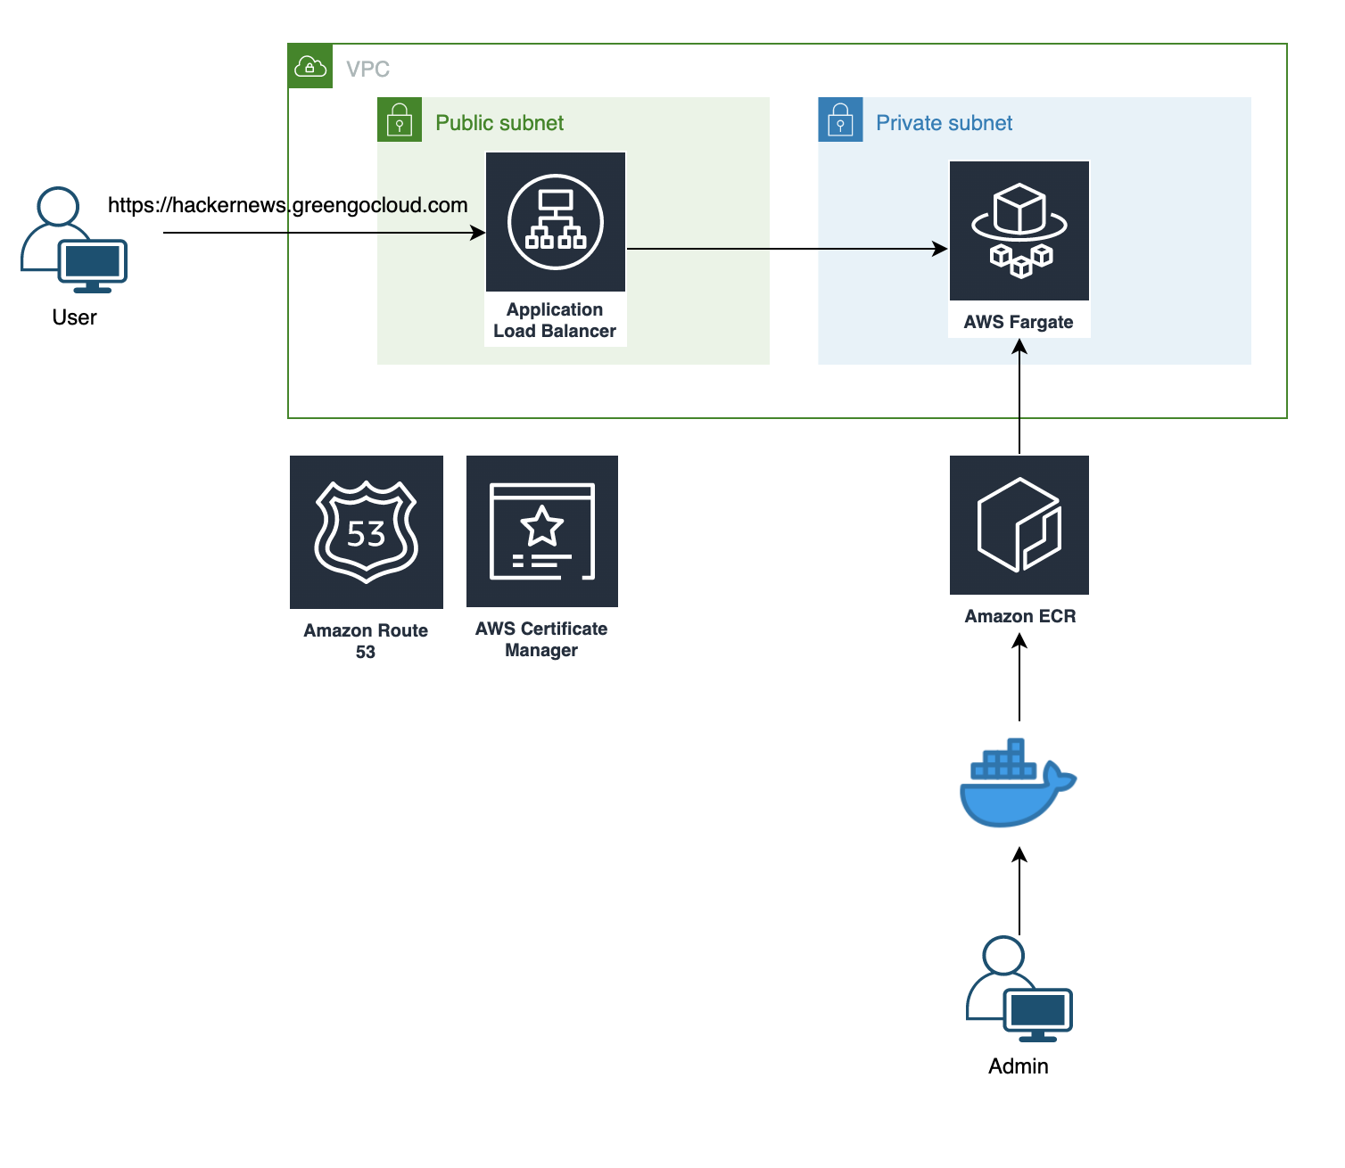



What we’re going to build…
Notes:
- We're going to build a HackerNews clone build upon HackerNews official Firebase API, Vue 2.0 + Vue Router + Vuex, with server-side rendering.
- AWS Fargate is a compute engine for Amazon ECS that allows you to run containers without having to manage servers or clusters. With AWS Fargate, you no longer have to provision, configure, and scale clusters of virtual machines to run containers. This removes the need to choose server types, decide when to scale your clusters, or optimize cluster packing. AWS Fargate removes the need for you to interact with or think about servers or clusters. Fargate lets you focus on designing and building your applications instead of managing the infrastructure that runs them.

Slide 7
Demo
Start the app locally
Install cdk
cdk init
Add ALB and Fargate service
Add custom domain
Make a change locally and update the service

Slide 8
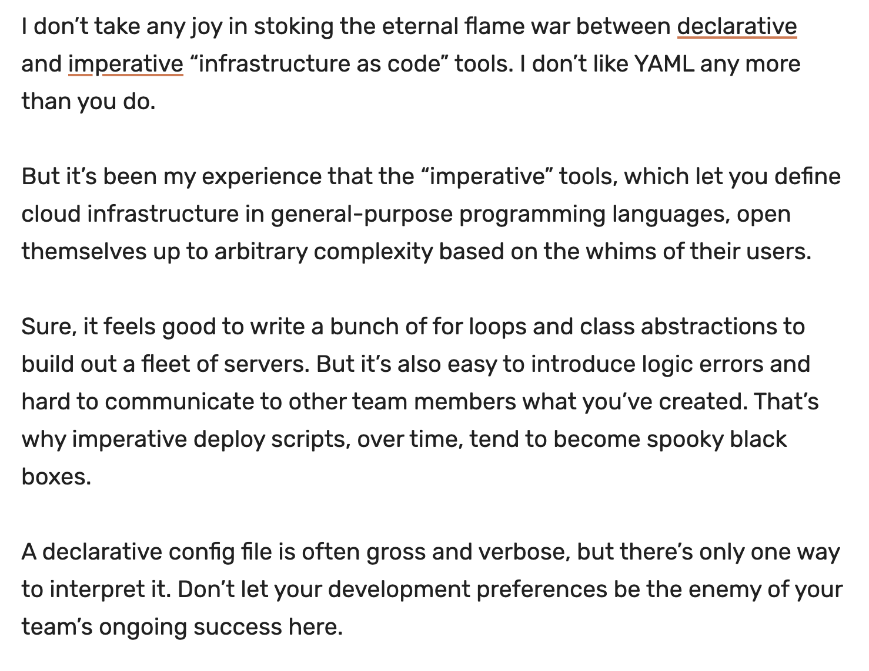
The catch…
No such thing as a silver bullet
Imperative vs Declarative
Ben Kehoe: https://acloud.guru/series/serverlessconf-nyc-2019/view/yaml-better
Still evolving…
Source: Forrest Brazeal - https://bit.ly/2uwdFb8

Slide 9
Wrap and resources
Resources
https://cdkworkshop.com/
https://github.com/aws-samples/aws-cdk-examples

Slide 10

That’s all for now…

